Slide 1
Flying for Life
The Worldwide Work of Mission Aviation Fellowship
Notes:
Thanks
Introduction
M-A-F:
Different from other aid agencies because we have Christian aims best epitomised by the parable of the Good Samaritan.
In today’s ‘connected world’, the irony is that never have so many people been so isolated.

Slide 2
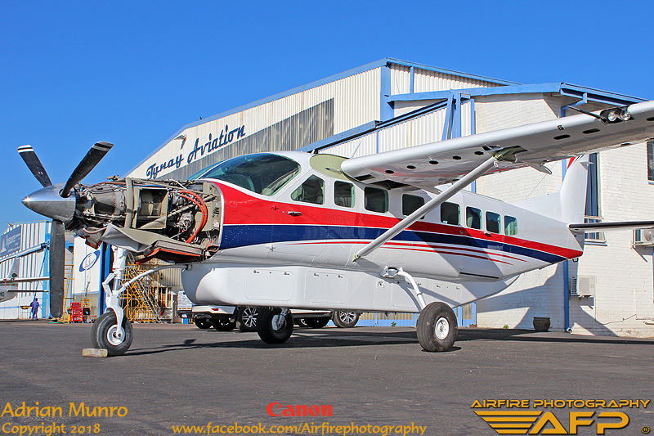
Servicing

Slide 3
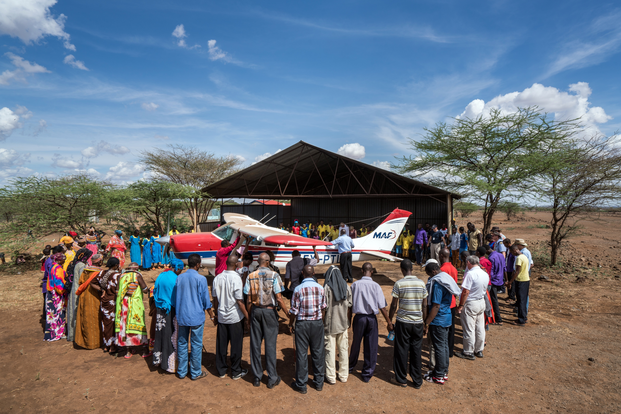
Prayers

Slide 4
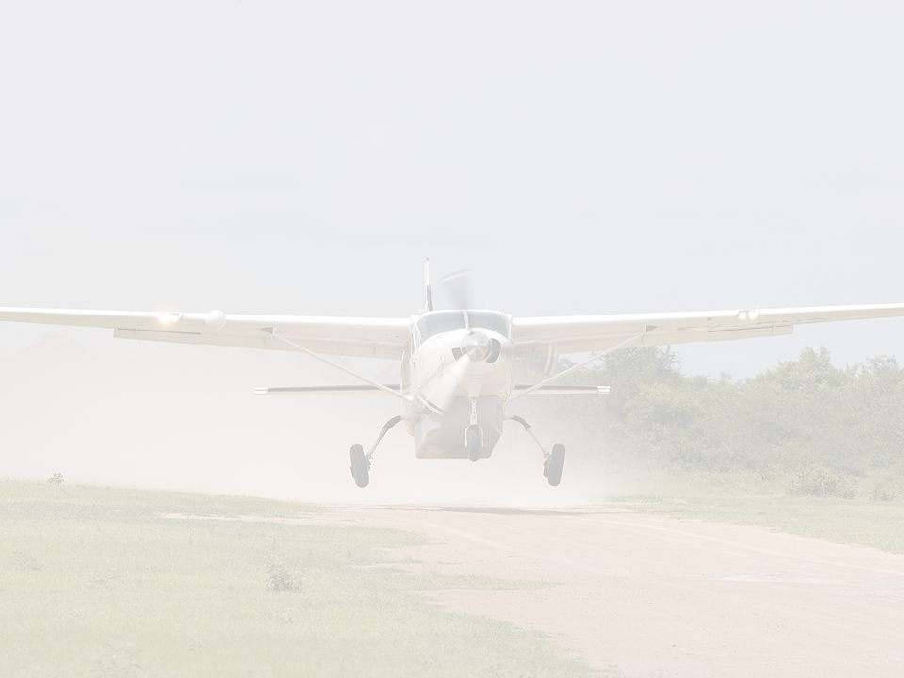
What is Mission Aviation Fellowship?
Where does MAF operate?
Why is MAF needed?
Our pilots
So what? – the difference that MAF makes
MAF today
Notes:
Short presentation: whistle stop tour of several countries
Whets appetite: sign up (without commitment) to our newsletter and read the ‘Hope has Wings’ book. It traces the history of MAF. It’s a real adventure story of hope, disaster, death, political unrest and how God’s hand guided people to persist in circumstances where others might have given up!

Slide 5
What is Mission Aviation Fellowship?
MAF is a Christian organization whose mission is to use light aircraft to bring people in developing countries the help they need.
Our ‘product’ is care for people, in body, mind and spirit.
Notes:
MAF serves those living out of sight, out of mind and out of hope. With land access denied by inaccessible terrain – due to natural disaster, war or political and economic crisis – thousands of communities are completely isolated.
We provide essential medical care, food, water, relief teams and church workers to those in desperate need.
Each flight carries practical help, spiritual hope and physical healing to thousands of men, women and children for whom flying is not a luxury but a lifeline.
MAF looks to help the whole person and community – Our product is……!

Slide 6
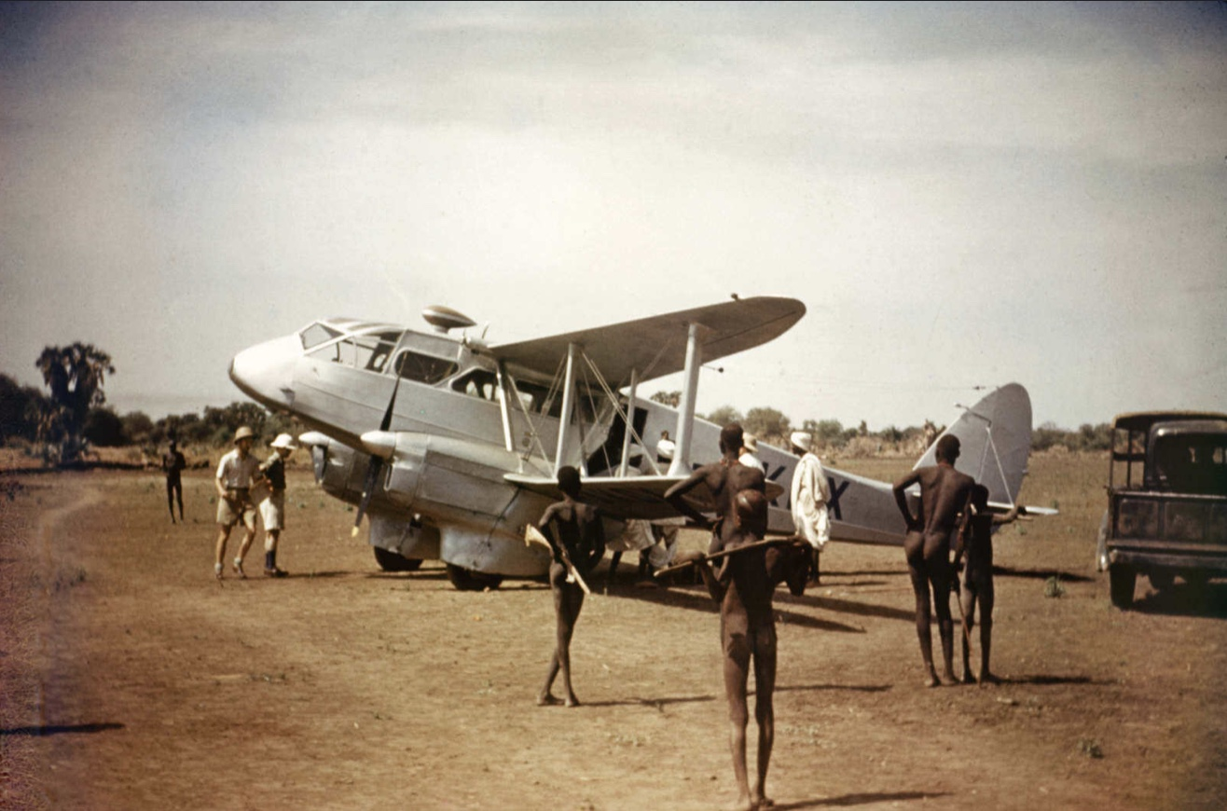
How did it all begin? – UK
1945: MAF UK founded by two RAF pilots and an engineer.
1948: Survey flight to Africa.
1950: Our first operational flight, Sudan.
Notes:
Simple idea: some WW2 pilots in the USA, UK and Australia how could their undoubted training and experience help people overseas. This idea took root. MAF USA was founded in 1945 and made its first operational flight in 1946. MAF Australia was founded in 1947 and after a survey flight to its northern territory, made its first operational flight in 1951.

Slide 7
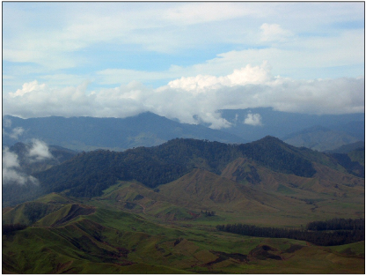
Why is MAF needed?
In many parts of the world, surface travel is difficult, dangerous or time-consuming.
Many remote communities are isolated by natural barriers like mountains, deserts, rain forest and swamps.
Notes:
MAF operates in difficult environments. In some parts, factionalism between people make travel inherently dangerous. Combination of remote areas, natural barriers makes for dangerous and time-consuming journeys.

Slide 8
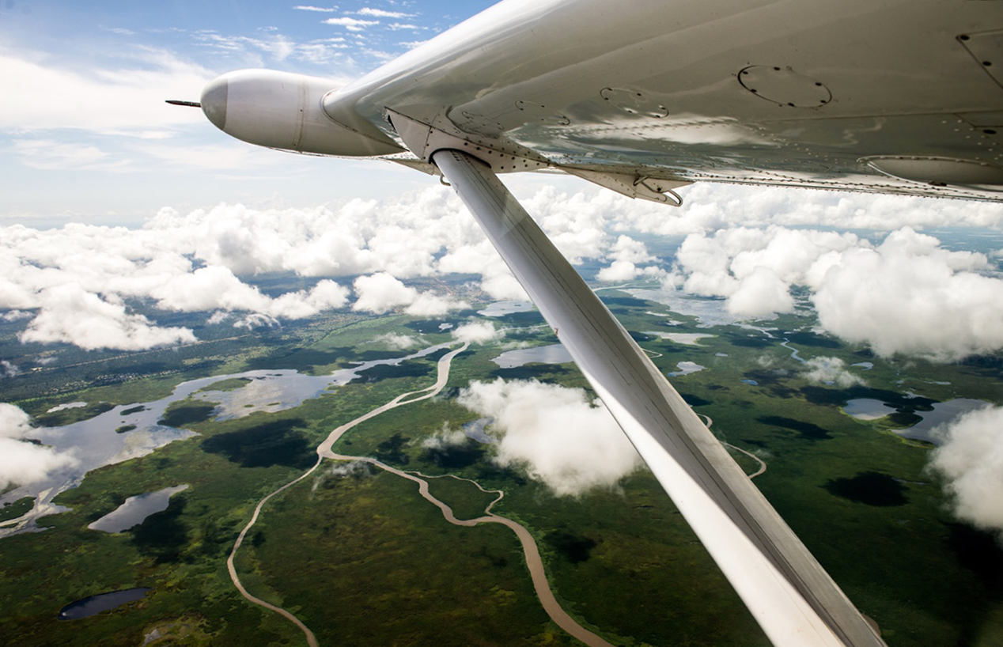
Why is MAF needed? – South Sudan
Notes:
Sudan is the country that has been longest served by MAF. It looks a beautiful country form the air. There is usually 3 months of good travel, six months of rain and 3 months of sodden ground making travel very difficult.

Slide 9
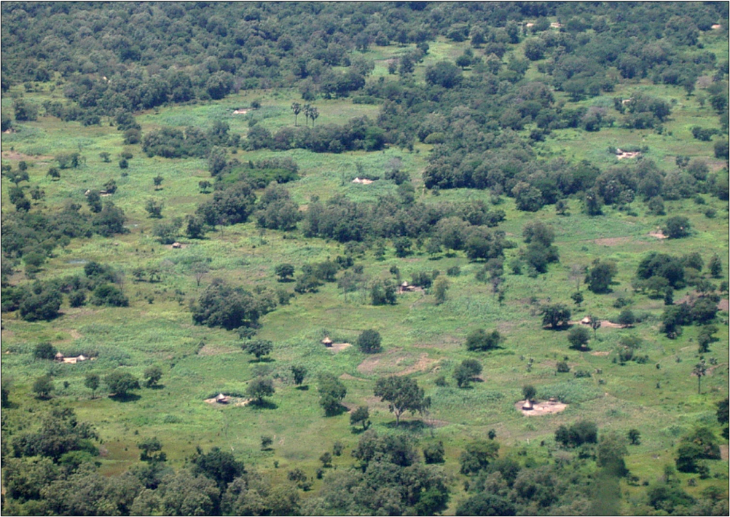
Why is MAF needed? – South Sudan
Stuart King, 1948: ‘...vast areas where there were no real roads at all, and what tracks existed were impassable for months at a time.’
Stuart King, 1948: ‘...vast areas where there were no real roads at all, and what tracks existed were impassable for months at a time.’
Derek Reeh, 2011: ‘From my experience of flying in Sudan regularly during the past year, nothing has changed.’
Notes:
You would have thought that transport systems had improved but no. These are comments from two of our most experienced operatives. But there are challenges faced in all the areas where MAF works.

Slide 10
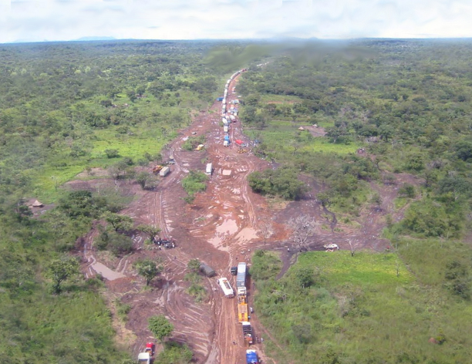
Why is MAF needed? – South Sudan
This is the main road from Uganda into South Sudan, in the rainy season. (Photo: 2008.)

Slide 11
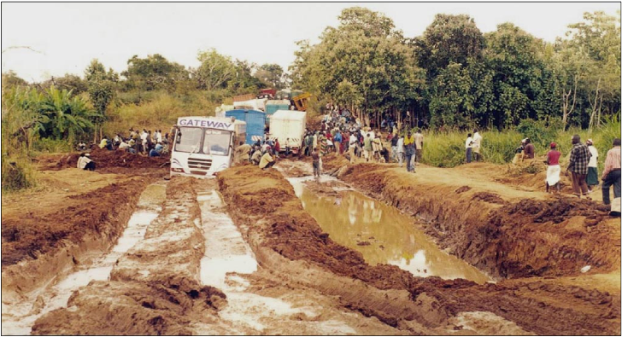
Imagine how long it will take to get through here
Notes:
Speaks for itself!

Slide 12
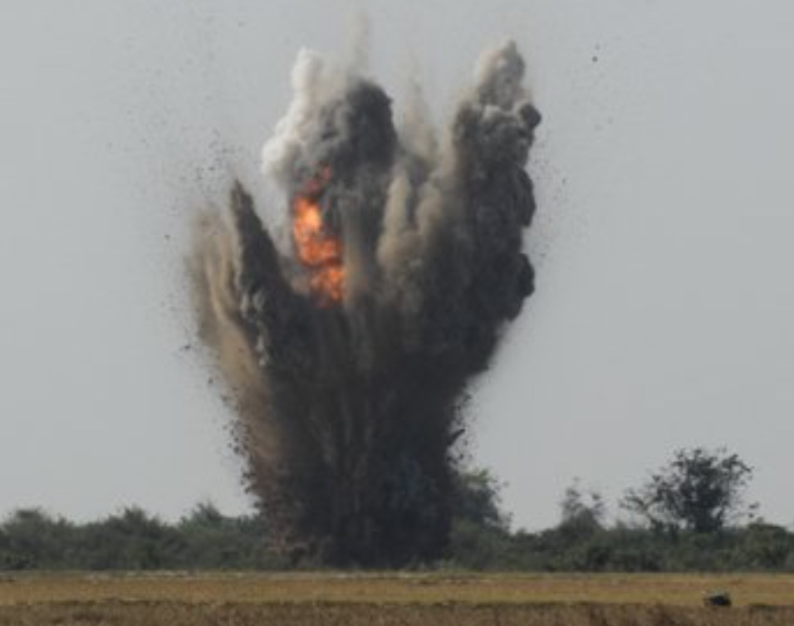
Why is MAF needed? – South Sudan
Notes:
Roads are not the only problem. This is a mine!

Slide 13
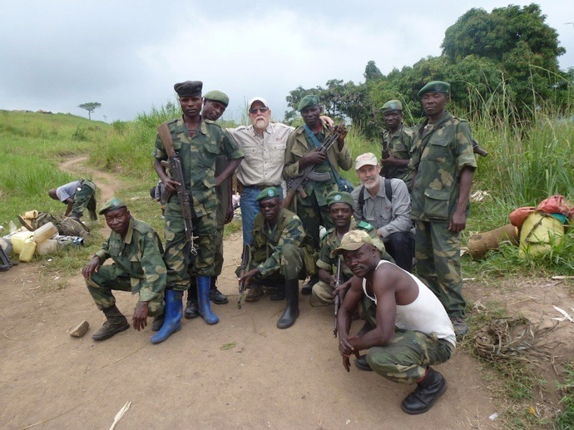
There may be other problems
In some places rebel militias or bandits make surface travel dangerous.
Notes:
Thieves and bandits make surface transport difficult. I’ve experienced Maoists in Nepal where I was in danger of being mugged. I put my money on different places about my person, in case I was robbed.

Slide 14
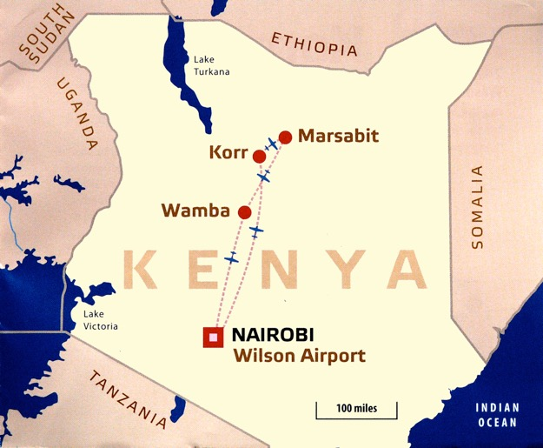
There may be other problems
Even in Kenya, car theft is regrettably common.
Long-distance buses and lorries are often badly maintained.
Many drivers keep going on drugs.

Slide 15
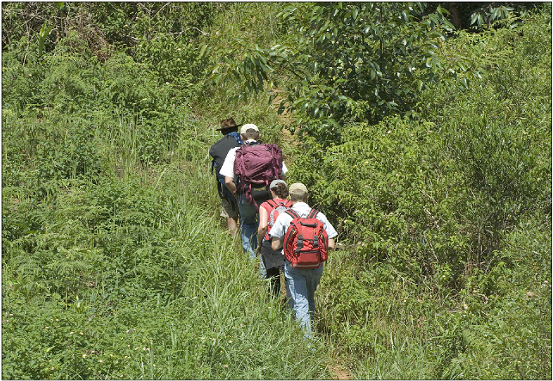
Why is MAF needed? – Madagascar
These missionaries in Madagascar have an arduous two-week trek through the rain forest to reach a remote village with no other access.
Notes:
Without transport infrastructure, each journey becomes a challenge.

Slide 16
Why is MAF needed? – Bangladesh
One third of the surface of Bangladesh, 3,500 sq miles, is water-covered under normal conditions.
When there are floods, another third may be water-covered.
But water transport cannot move people or goods quickly.

Slide 17
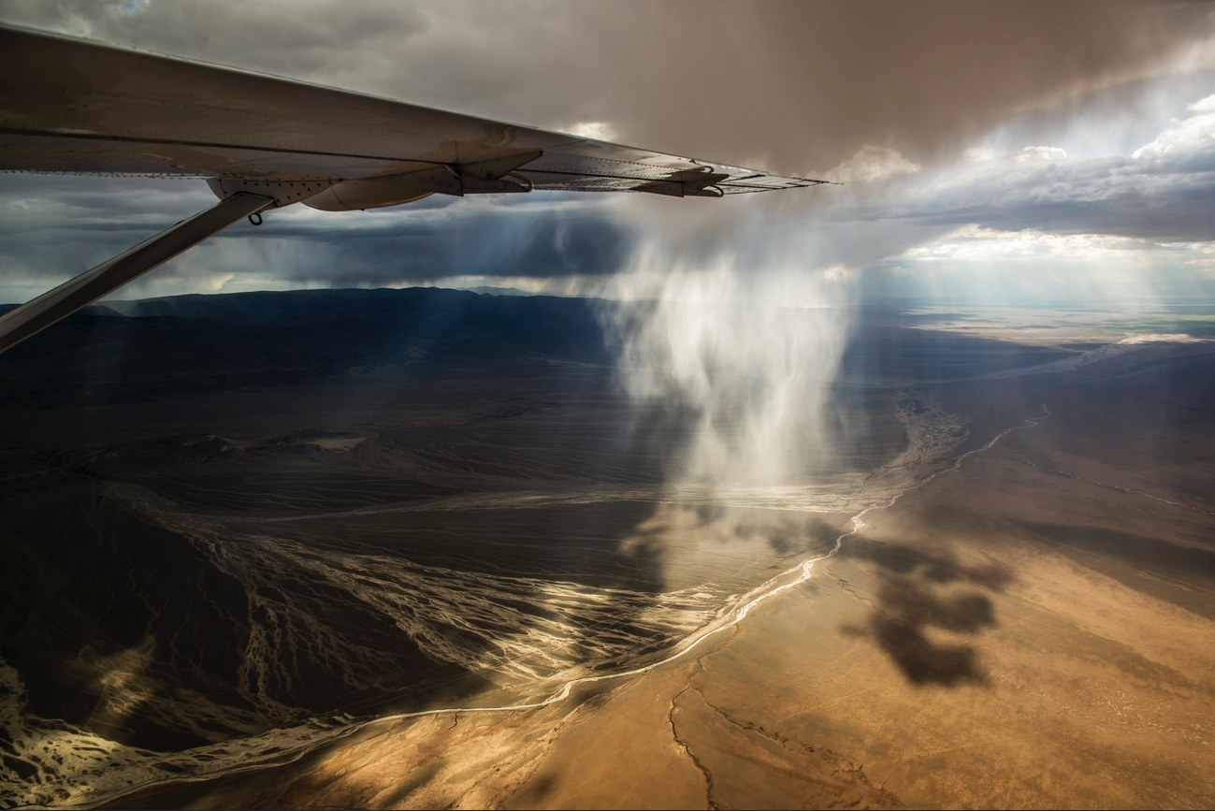
Why is MAF needed? – Mongolia
World’s 18th largest country, 6.5 x area of UK, but only 3,000 miles of paved roads. (UK c. 250,000 miles.)
Most sparsely populated: three million people, less than 5% x UK.
Recorded temperatures: -57 to +38ºC
Yearly average: -30 to +20ºC

Slide 18
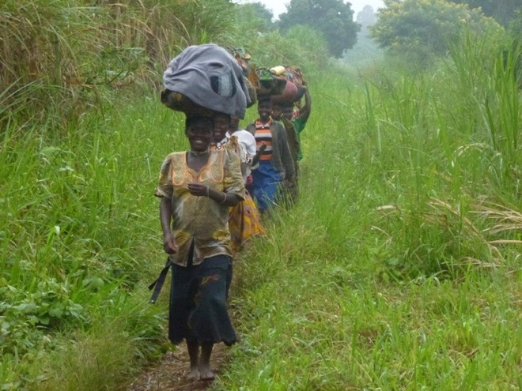
In some places, roads are getting worse, not better
In the 1980s, the World Bank estimated that south-east Zaire was losing 2,500 miles of road per year.
This photo: August 2012.
Notes:
We use some of the most basic and challenging airstrips. Steep as 1:8 Some are in narrow valleys cut off by cloud in the afternoon.

Slide 19
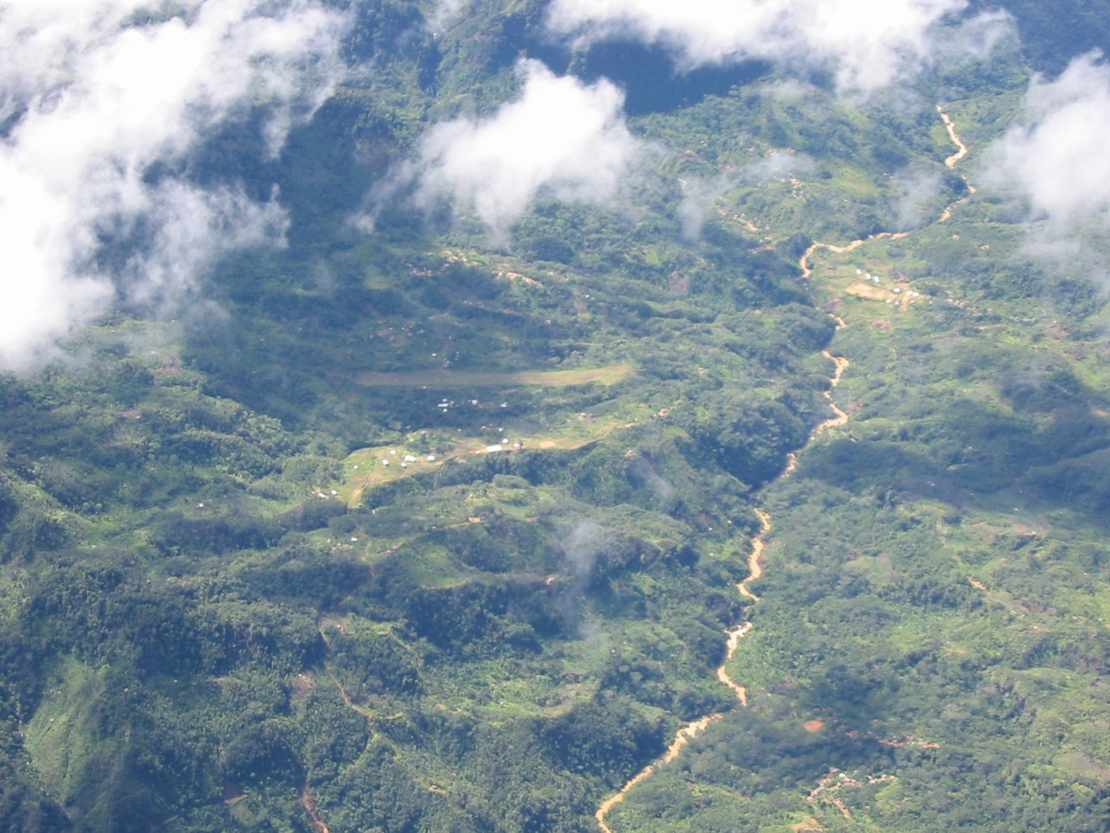
Notes:
This is a village in Papua where 600 people live but no doctor. Next nearest village is 5 miles away where there is a doctor – 4 day walk through jungle, across rivers – hazardous. MAF can do it in a 15/20 minute flight. A sick person may not survive the overland journey – they probably will survive the short flight.

Slide 20
And so, in short...
In many unimproved parts of the world, there is a need for safe, dependable and quick travel.

Slide 21
MAF provides the answer
Notes:
MAF aircraft bring help to people in places and situations where flying is not a luxury but an essential lifeline. Often we are the only operator serving a remote area.

Slide 22
Notes:
This is a safe landing. Imagine the skill in the next slide.

Slide 23
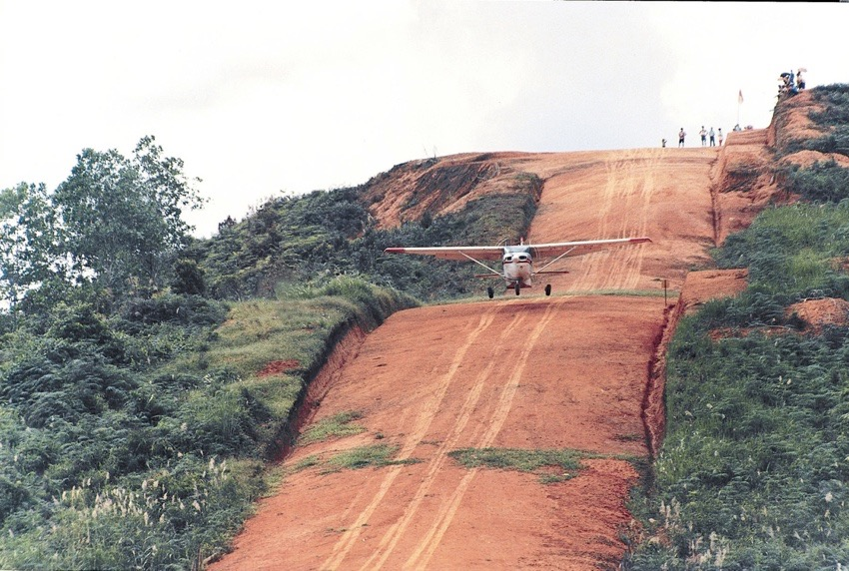
It isn’t easy
Notes:
MAF flyers are all experienced commercial pilots with special training. They have to land in difficult conditions in remote areas.

Slide 24
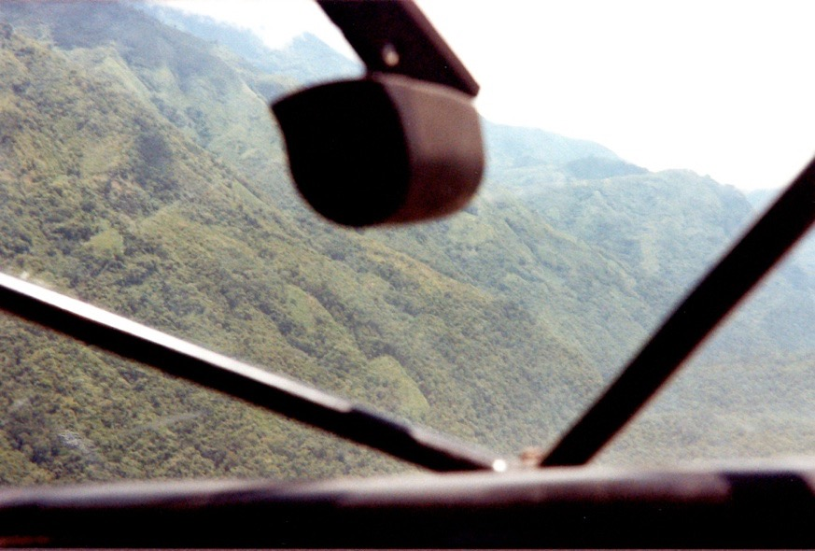
It isn’t easy
Notes:
Where do you think the airstrip is?

Slide 25
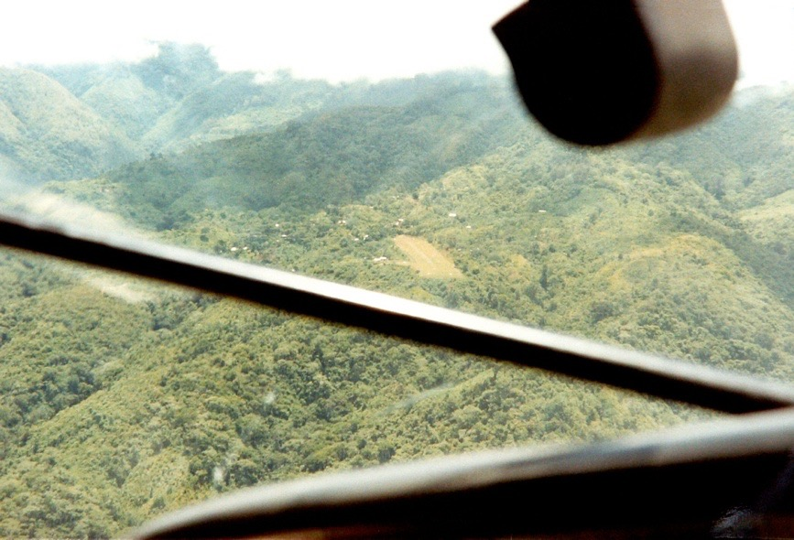
It isn’t easy
Notes:
Even when you get there, can you get out?

Slide 26
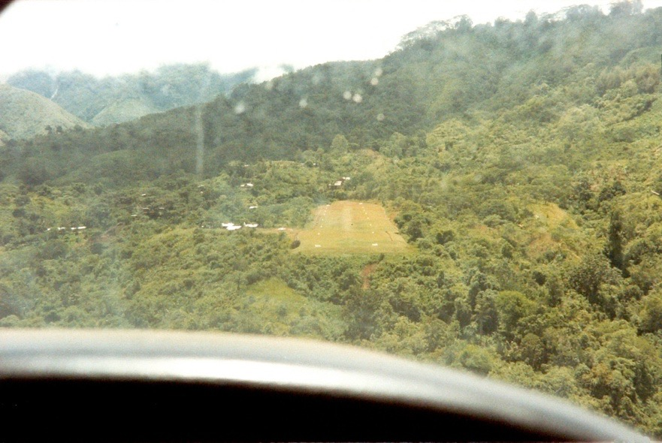
It isn’t easy
Notes:
This is a one-attempt landing. Make a mistake and you’re in serious trouble.

Slide 27
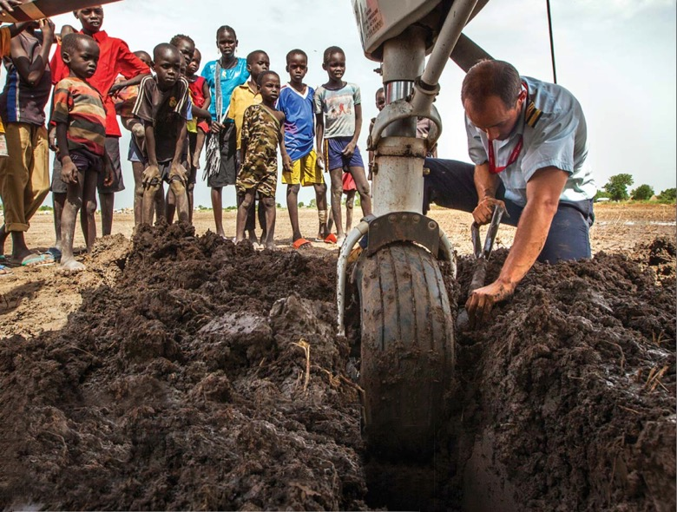
It isn’t easy
Notes:
Even when you get there, can you get out?

Slide 28
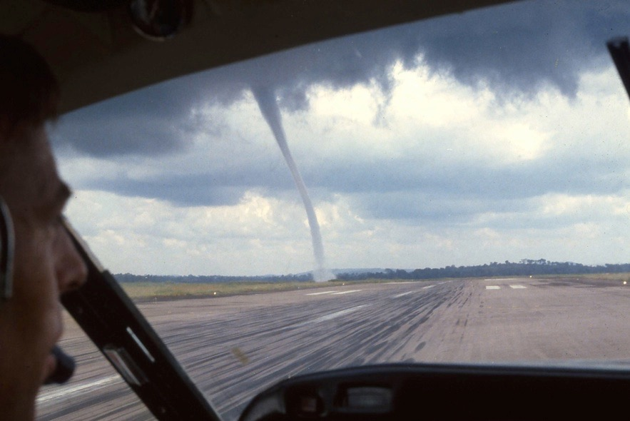
And there can always be surprises!

Slide 29
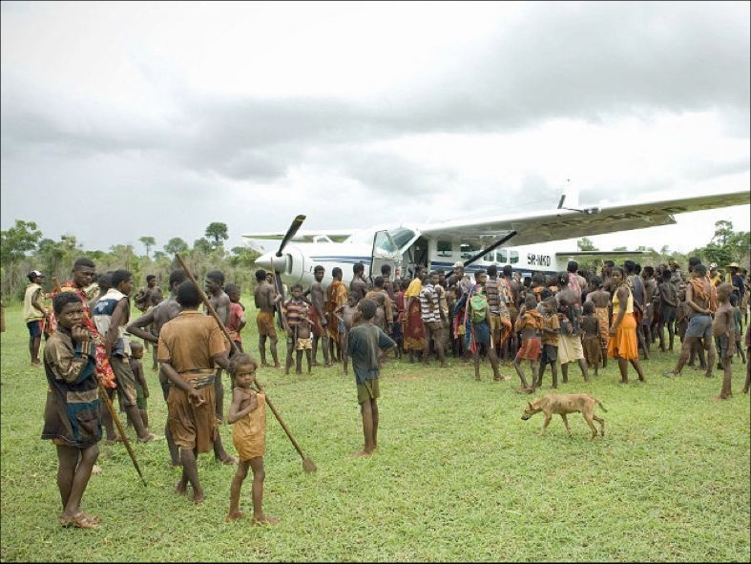
But we are always welcome...

Slide 30
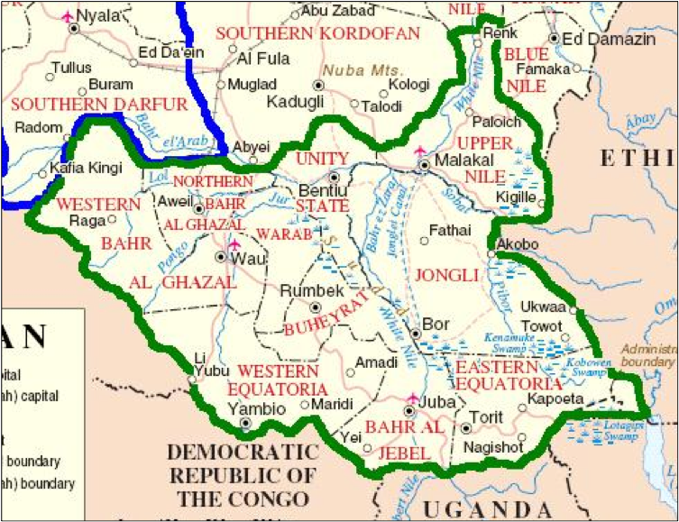
A typical day’s flying in South Sudan
1,000 nautical miles.
Six destinations.
7 hours’ flying.
And an 11-hour duty day...
Lokichoggio
...and all this in temperatures up to 40ºC.

Slide 31
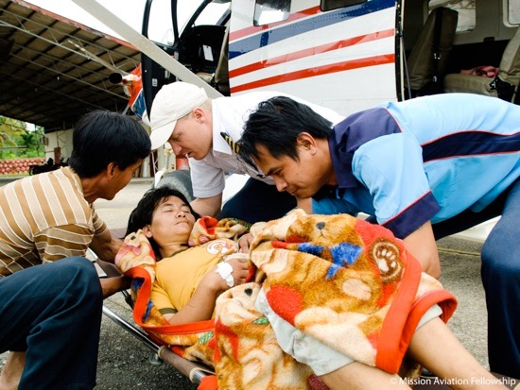
MAF: so what?
When life or health is at stake, MAF aircraft become air ambulances.
We do this without charge for people who cannot pay.
Notes:
We bring emergency aid for refugees displaced from their homes by natural disasters or human conflict.
Sometimes the only external help that people get comes from a MAF aircraft.

Slide 32
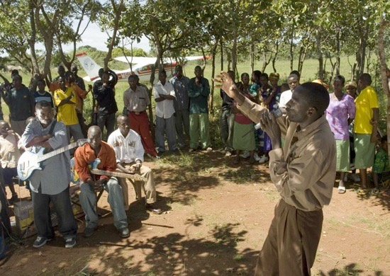
The difference MAF makes – Tanzania
Pastors in Tanzania can fly from one village to another in minutes, instead of having hours of rough driving.
They can reach and teach many more people.
Notes:
Of course we are a Christian organsiation. So we transport pastors to spread the word of God widely.

Slide 33
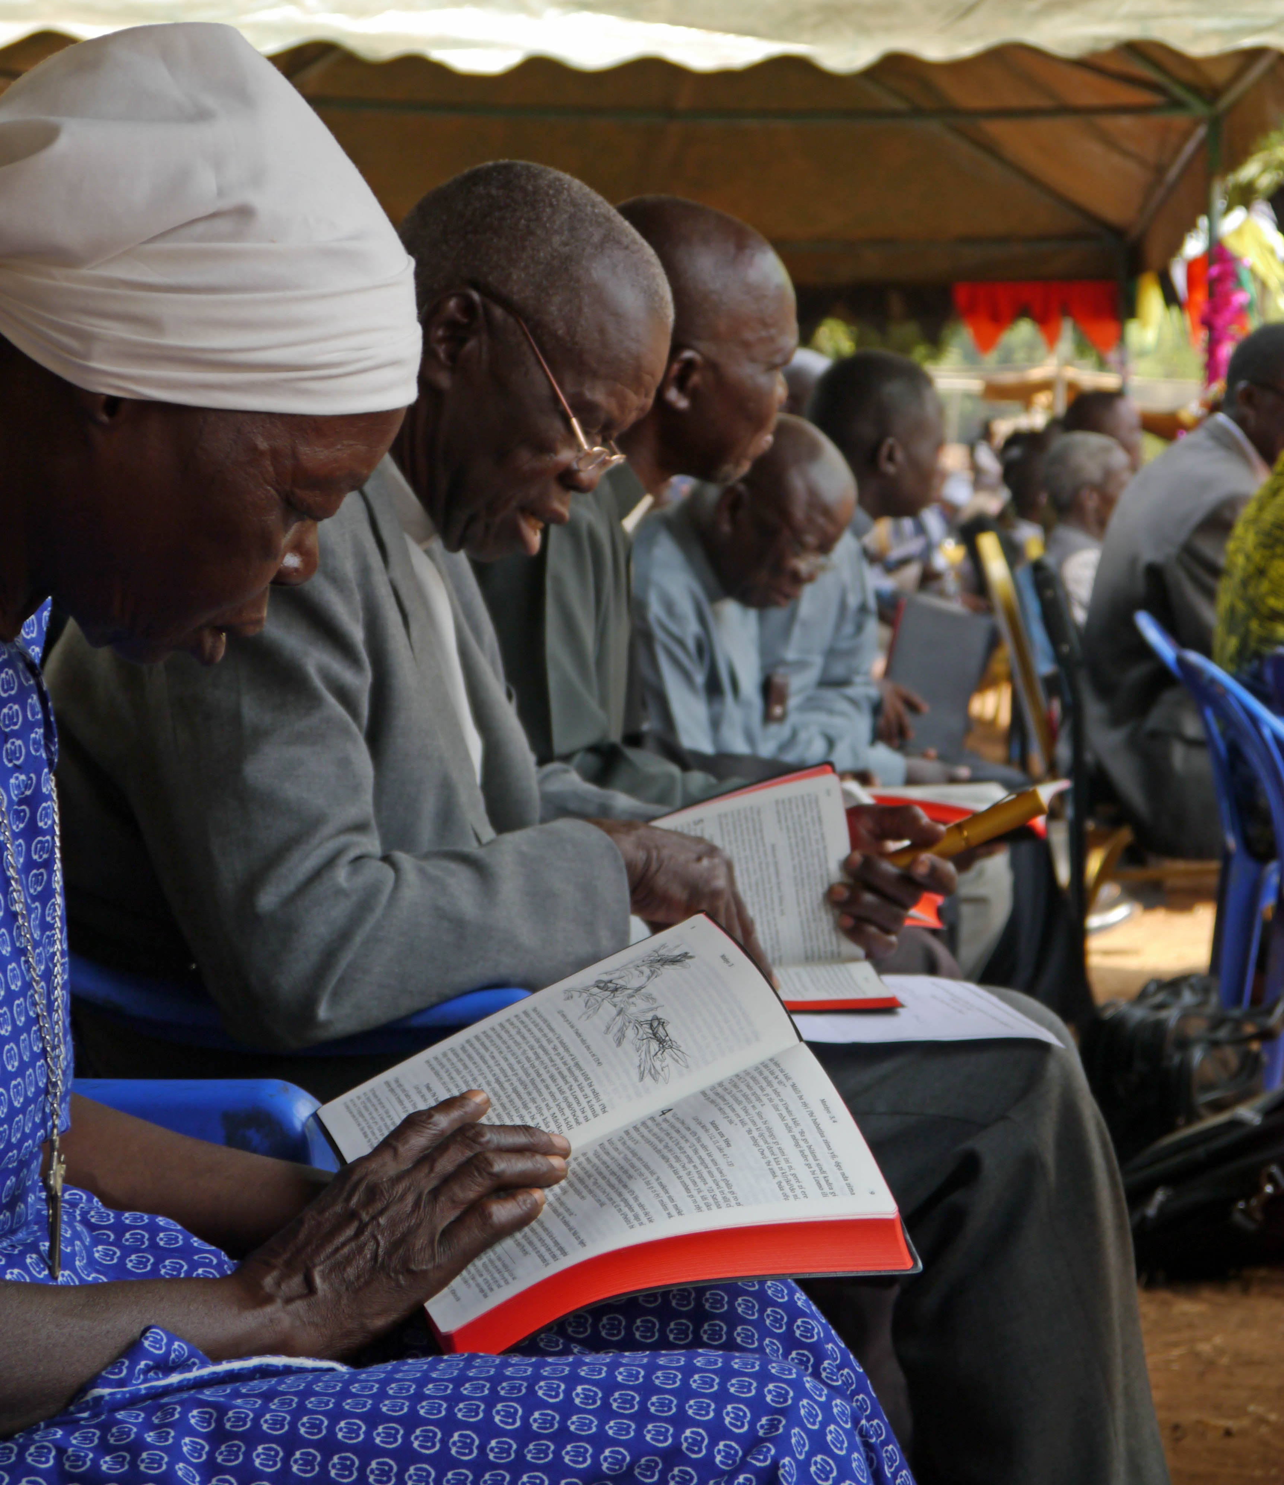
The difference MAF makes – South Sudan
The first Baka Bibles arrived at Juba last December.
But because of fighting even the UN had not sent a convoy down the 180-mile road from Juba to Maridi for several years.
MAF has flown the Bibles to Maridi without charge.
‘From now on, Jesus will speak to us in Baka!’

Slide 34
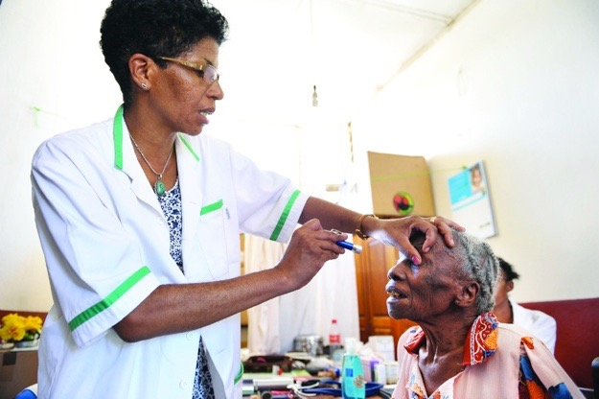
The difference MAF makes – Kenya
Using MAF, eye-care specialists can reach outlying clinics in hours and minutes instead of spending a day travelling each way…

Slide 35
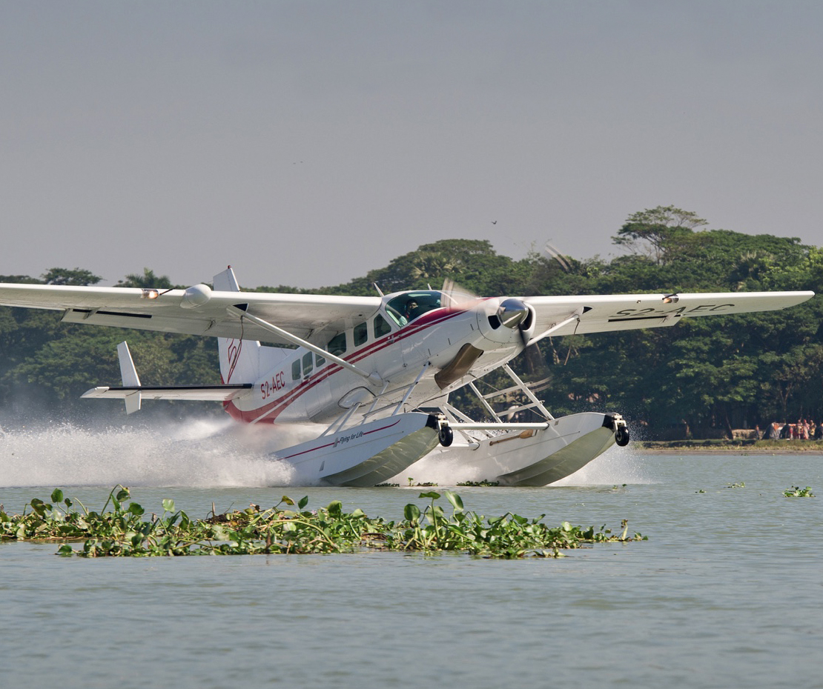
The difference MAF makes – Bangladesh
Our MAF floatplane, the only one in Bangladesh serving humanitarian organisations, provides safe and effective travel across the waterways.

Slide 36
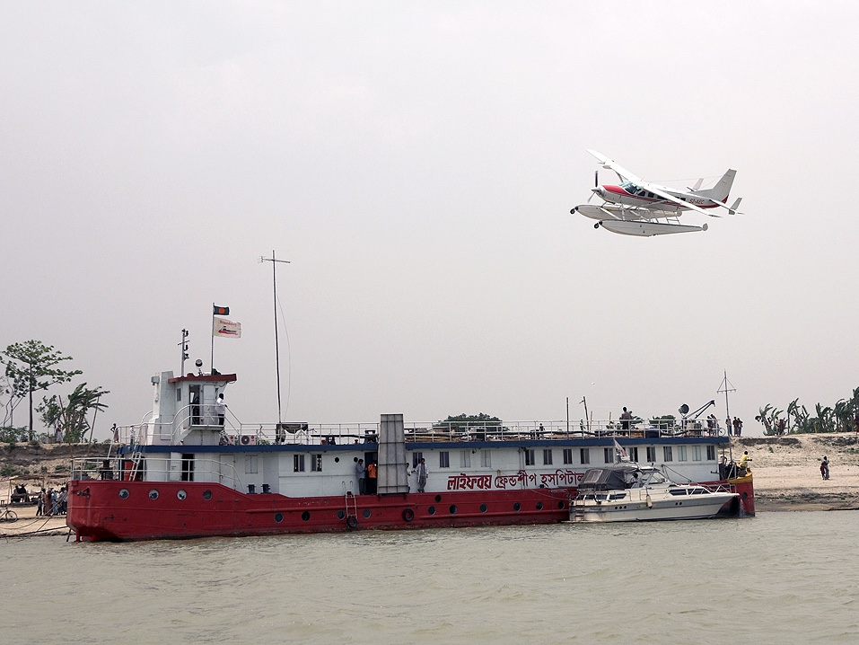
The difference MAF makes – Bangladesh
We serve over 80 agencies and NGOs here…
…including floating hospitals, like this one.

Slide 37
The difference MAF makes – Haiti

Slide 38
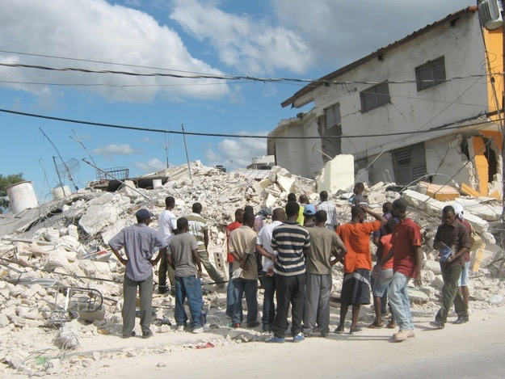
The difference MAF makes – Haiti
MAF USA usually had three aircraft based in Haiti.
After the 2010 earthquake and after last year’s hurricane, we put in an experienced Disaster Response Manager and a fourth aircraft.

Slide 39
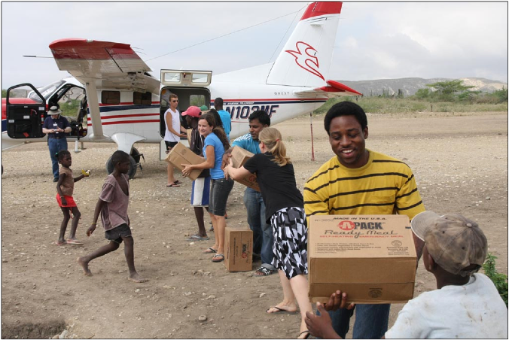
The difference MAF makes – food
In less than three weeks, we carried 2,500 passengers and c.230 tonnes of cargo.
In eight weeks, we carried c.120 tonnes of food alone.
Notes:
When natural disaster strikes, we fly in water-purification kits, food and medical supplies.

Slide 40
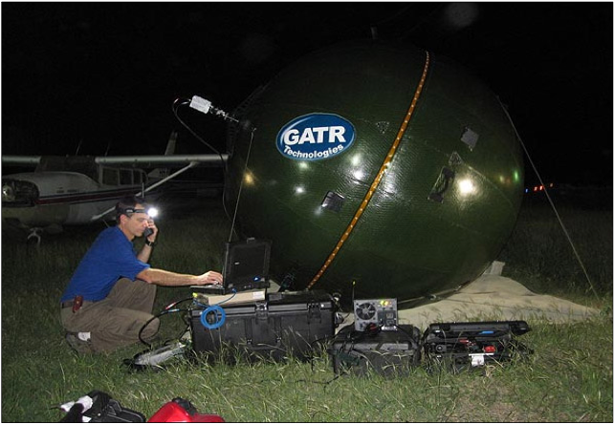
The difference MAF makes – communications
We also put in satellite communication equipment.
We could then provide reliable communications for relief agencies.
News agencies also used it, to send out their reports.
Notes:
It’s likely that the first news reports on BBC, ITV or SKY were initially using the MAF satellite.
So far, we've looked at disaster relief in global terms. But behind all of this are individual stories!

Slide 41
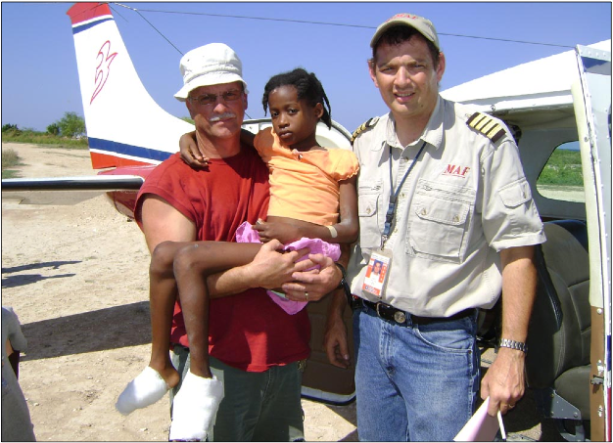
The difference MAF makes – healing
We also flew medical and relief agency personnel where they were needed...
...and brought casualties to hospitals where they could have the treatment they needed.
Notes:
This is Meka (10). She was badly injured in an earthquake in La Gonave. Her feet were described as having gone through a mincing machine.
A MAF pilot was due to take three US surgeons to a hospital but the flight was cancelled. He was called to take Meka to hospital. En-route he was diverted back to Port au Prince to take the surgeons to hospital. All four were taken. By coincidence or providence all three doctors were orthopedic surgeons. A few weeks later Meka left hospital…

Slide 42
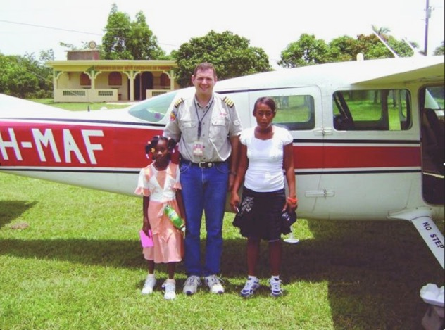
The difference MAF makes – healing
We also flew medical and relief agency personnel where they were needed...
...and brought casualties to hospitals where they could have the treatment they needed.
Notes:
This is Meka in smart socks and trainers able to walk and run and looking forward to becoming a teenager

Slide 43
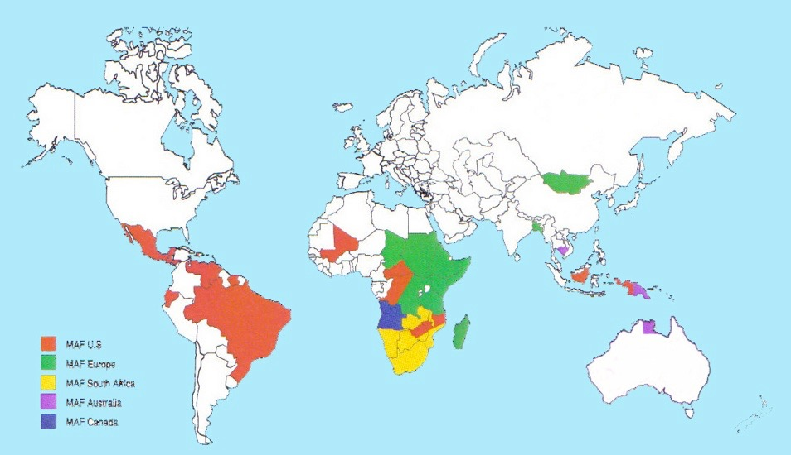
MAF today
MAF International formed 2006.
We serve in 37 countries, with flying programs in 26.
MAF USA
MAF Europe
MAF South Africa
MAF Australia
MAF Canada
More than 1,300 staff (c.1,000 national), and c.131 aircraft, flying to >1,400 communities.
Notes:
MAF has grown organically wherever there is need.

Slide 44
Notes:
Working in partnership with 1500+ organisations – supporting their work. Regular, projects, emergencies, aid work in disasters. MAF enables partners to do more, be more efficient, safer, less tiring. To do what otherwise they would be unable to do. MAF is vital.

Slide 45
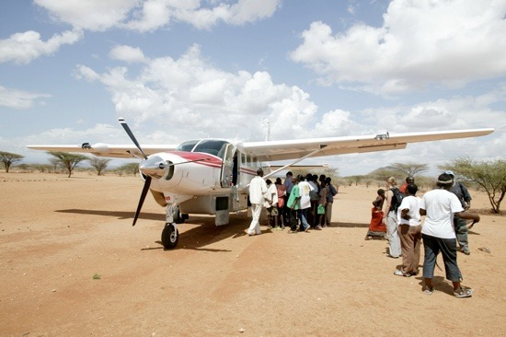
MAF today 2018
Flew 39,000 hours
Flies 8 million km (199 aro9und equator)
Carries more than 157,000 passengers and 6 million kg of freight.
On average, an MAF aircraft takes off or lands somewhere in the world every 4½ minutes.
Notes:
These are some interesting facts that show the extent to which we work.

Slide 46
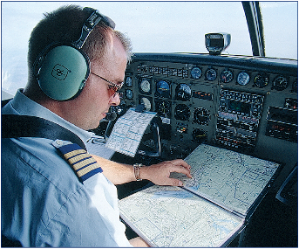
Where do our people come from?
MAF’s multi-national team includes:
Pilots, engineers and radio technicians.
Managers, accountants and secretaries.
IT specialists, builders and administrators.

Slide 47
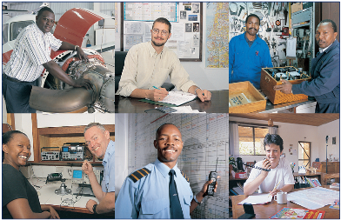
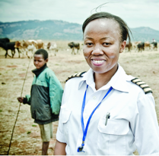
Where do our people come from?
As many as possible are recruited locally.
MAF expatriate staff are Christians endorsed and supported by their home churches.
Notes:
At one time 1:4 were expatriates; now it’s the opposite.

Slide 48
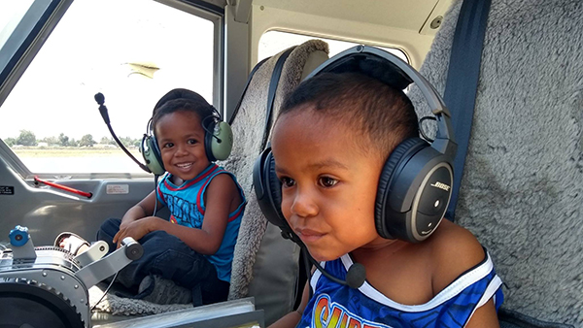
Notes:
We like to start them young!

Slide 49
IF WE CAN REACH YOU, WE CAN REACH THE PEOPLE WE SERVE AROUND THE WORLD...
Read the story: Hope Has Wings, Jungle Pilot, and other books.
Sign up here and now to come with us on a journey of discovery: It’s free, and there are no commitments.
Accept the MAF Challenge: Tell someone else about MAF tomorrow! Recommend a presentation to other clubs or groups or churches.
Follow the work: www.maf-uk.org.

Slide 50
From the trust and obedience of a handful of airmen and women in 1945...
God has brought into being a major air service provider...
Bringing love, help and hope to needy people in the name of the Lord Jesus Christ
Notes:
Wherever you see disaster, there is a good chance that MAF has flown people in.
Poem Ch 31

Slide 51
Celebrating 75 years of success
Thank You

